Slide 1

The INRIA Project LAB HPC-BigData: Addressing the HPC/Big-Data/IA Convergence
Bruno Raffin,
INRIA Grenoble Rhône-Alpes
Lyon, October 2018

Slide 2
The HPC-BigData Project Lab
An INRIA funded project (2018-2022)
  Gather teams from HPC, Big Data and Machine Learning to work on the convergence
INRIA teams:
  HPC teams: DataMove, KerData, Tadaam, RealOpt, Hiepacs, Storm, Grid’5000
  IA teams (and Big Data): Zenith, Parietal, Tao, SequeL, Sierra
External partners:
  Academic: Lab Biologie Théorique (CNRS Paris)Academic: Argonne National Lab (USA)
  Industry: ATOS/Bull, ESI-group
https://project.inria.fr/hpcbigdata/

Slide 3
The Convergence
Three Research Directions:
    Infrastructure and resource management
    HPC acceleration for AI and Big Data
    AI/Big Data analytics for large scale scientific simulations

Slide 4
HPC versus BigData/AI
HPC
→Performance comes first
→ Low level programming
  MPI+OpenMP
→ Thin software stack
→ Stable software libs
→ HPC centers
Jobs run a few hours on thousands of cores:
  Sensitivity Analysis : 30 000 cores for 1h30 [Terraz’17]
  Exastamp material simulation: 8000 cores for a few hours
  Big Data/AI
→ Ease of programming comes first
→ High level programming
  Spark, Flink, TensorFlow, Pytorch
→ Thick software stack
→ Quickly changing software libs
→ Cloud platforms
Jobs run a few days on tens of nodes:
  Pl@ntNet learning: one week on 4 GPUs
  AlphaGo Zero ltraining: 70 hours on 64 GPU workers and 19CPU parameter [Silver’17]
  ResNet-50 on 256 GPUs in 1 hour (mini-batch training) [Goyal 2017]
Parallelism for scalability

Slide 5



Some of our Software Assets
StarPU
Machine Learning in Python
Light yet Flexible
Batch Scheduler
Task Programming for
Hybrid architectures
FlowVR, Melissa, Damaris
On–line data processing engines for HPC
Deep Learning based App
for plant identification

Slide 6
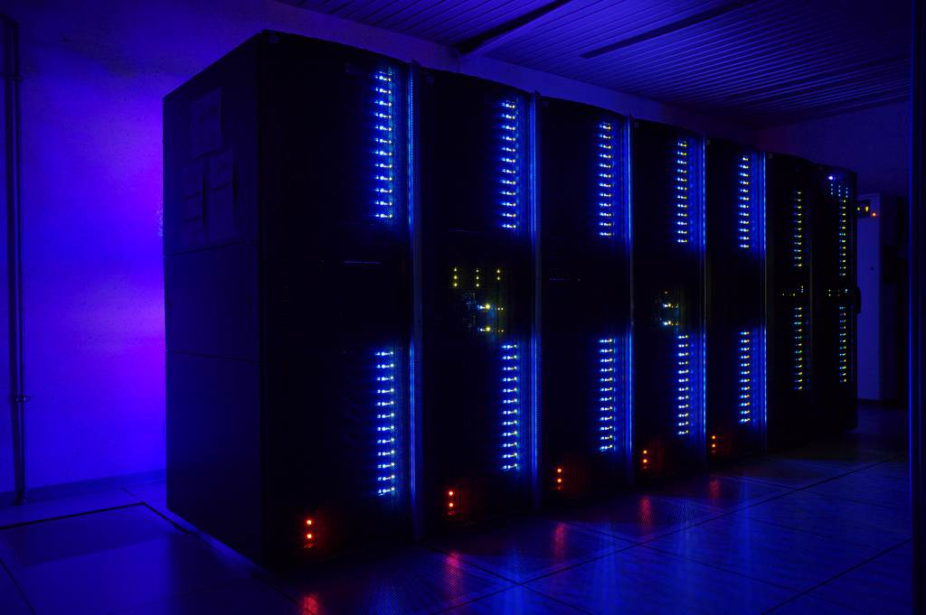
Infrastructure and Resource Management
HPC Infrastructure for AI:
New needs:
    Accelerators (GPUs or other)
    Large resident data sets (learning & benchmarks) (PlantNet: 10 TB of raw data)
    Very long runs (days)
    Fast changing software stacks (TensorFlow, PyTorch)
On-going work on AI/HPC compliant resource sharing approaches
Playground: Grid’5000, Genci experimental GPU cluster, etc.
Get data close to the compute nodes:
HPC versus Cloud platforms: External file system versus on-node disks
But changing: on-node persistent storage for energy and performance (burst buffers, NVRAM): Locality aware resource management

Slide 7
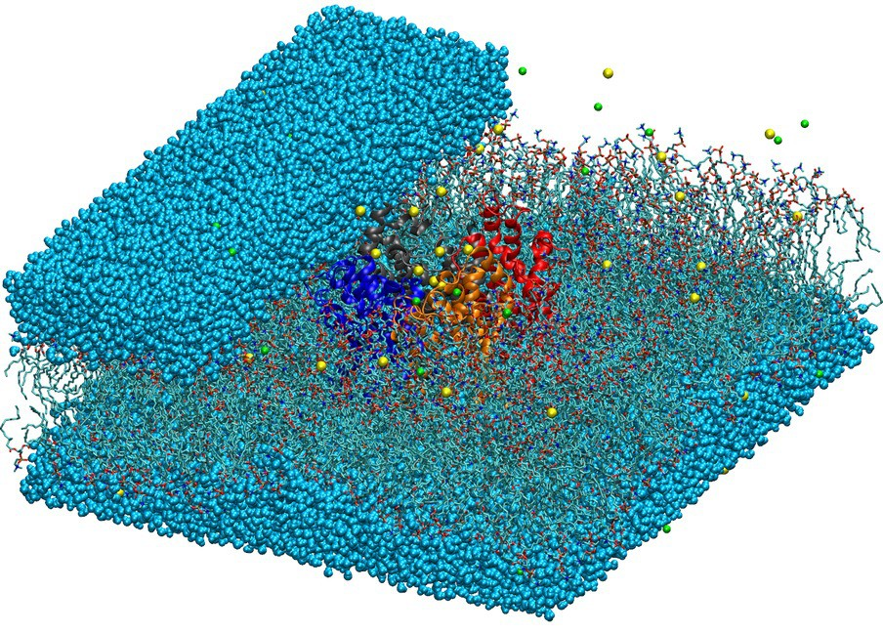
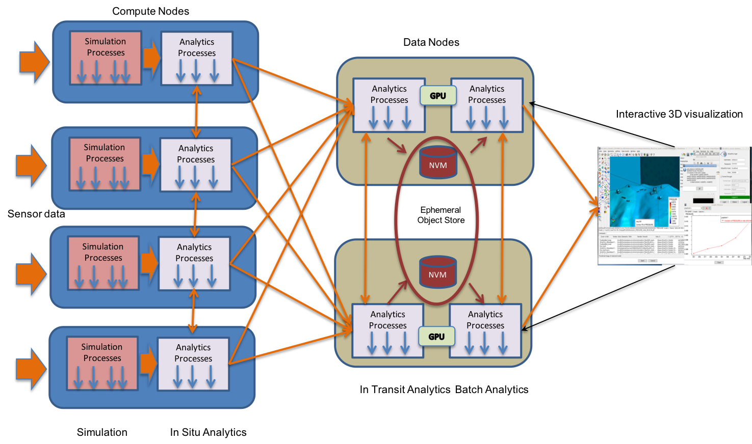
AI/Big Data Analytics for
Large Scale Scientific Simulations
Molecular dynamics trajectory analysis with deep learning:
Dimension reduction through DL
Accelerating MD simulation coupling HPC simulation and DL
Flink/Spark stream processing for in-transit on-line analysis of parallel simulation outputs
[ISAV’18]

Slide 8
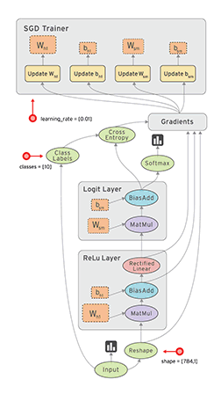
HPC for AI
Shallow Learning
Accelerating Scikit-Learn with task-based progamming (Dask, StarPU)
Deep Learning:
TensorFlow graph scheduling for efficient parallel executions:
Scheduling for automatic differentiation and backpropagation
Recompute versus store frontward results
Linear algebra and tensors for large scale machine learning
Large scale parallel deep reinforcement learning:
TensorFlow
Self-learn to play Atari games
[Nair et al. 2015]

Slide 9
Artificial Neural Networks
Activation function
Weight optimization by stochastic Gradient descent
(backpropagation)
Example x_{i}
Output: o_{i}
Compute error on output
Backpropagate error and compute weight updates

Slide 10
Deep Learning
ResNet-34
Today’s neural networks are deep and complex:
Hyperparameter setting has become
a very complex task -> learning
for discovering hyperparameters ?
[HE-CVPR2016]

Slide 11
Parallelizing Deep Learning
Parameter update function
Generic learning process: W^{t} = F(D,W^{t-1})
Often the parameters updates are computed after presenting a batch of
examples (batch learning)
2 main sources of parallelism:
  Data parallelism: distribute the learning set
  Model parallelism: distribute the model parameters
Learning Data
Model Parameters

Slide 12
Data Parallelism
[Goyal 2017]
Duplicate the model (one per worker)
Partition the batch into P minibatches, one per worker
Synchronous update (TensorFlow):
Loop:
Server sends parameters to all Workers;
Workers compute parameter updates
on their mini-batch;
Server get updates from all Workers;
Server compute a global model update;
Server update parameters;
EndLoop
Limitations:
- Server is a bottleneck:
gets P sets of model parameters
- minibatch size affects learning convergence
Worker
W_{i}
Worker
Server
W
Worker
W_{j}
Compute the
mean of W_{i}
Worker

Slide 13
Data Parallelism
Fix the bottleneck: suppress the server and perform a all-reduce
Baidu initially proposed a modified version of Tensorflow based on MPI, now available in Horvod (Uber, still Tensorflow+MPI)
Worker
Worker
Worker
Worker
All-Reduce (model weights)
Communication cost per worker is now independent on the number of workers

Slide 14
Data Parallelism:
Asynchronous Updates
Asynchronous Stochastic Gradient Descent:
  Each worker update asynchronously the model parameters
  Proven convergence under certain conditions [Hogwild! 2011]
  But practically convergence may be affected in such a way that it outweighs the performance gain from asynchronism.
Worker
Worker
Shared Memory
Async. weight
updates
Worker
Worker

Slide 15
Software 2.0
Software 1.0
  Deterministic computations with algorithms
  Computation must be correct for debugging
Software 2.0 [introduced by A. Karpathy]
  Probabilistic machine-learned models trained from data
  Computation only has to be statistically correct
  Creates many opportunities for improved performance
[K. Olukotun Keynote at ISCA 2018]

Slide 16
Software 2.0
[From K. Olukotun
Keynote at ISCA 2018]
Leverage the stochastic nature of ML for loosening data dependencies constraints and
thus support better parallelization.

